Slide 1
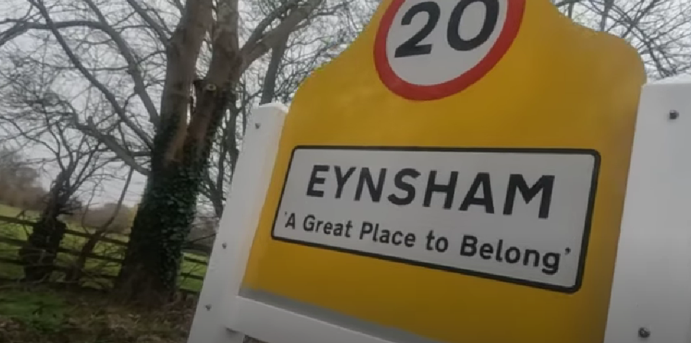

Stewardship Case Study
Notes:
Explain Vision Statement

Slide 2
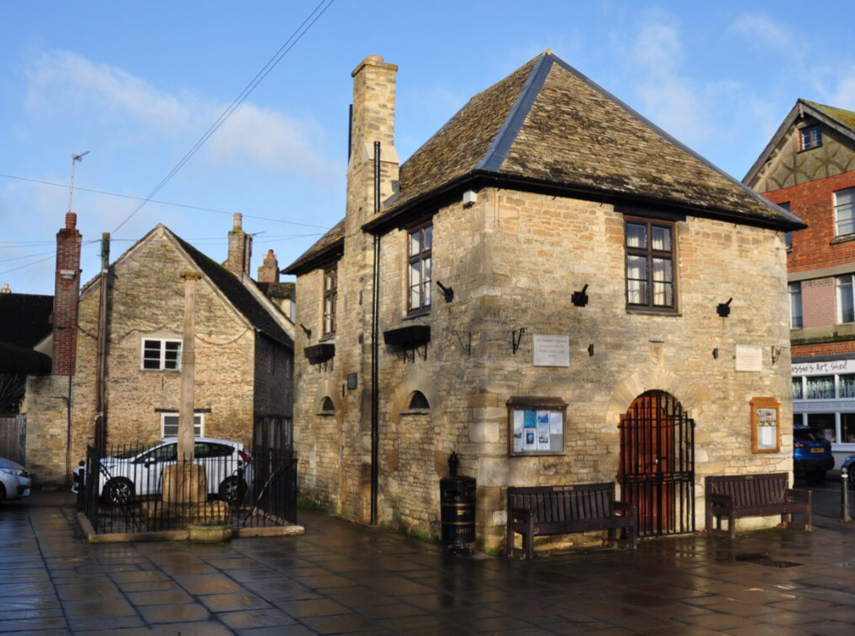
Agenda
Introductions
Setting the scene
Our approach
Why Stewardship?
Benefits
Challenges
Next Steps

Slide 3
Introductions
Ross Macken
Chair of Eynsham Parish Council
  Resident since 2012
  Councillor since 2015
Katherine Doughty
18 years' experience as a clerk
Clerk of Parish Council since 2017

Slide 4
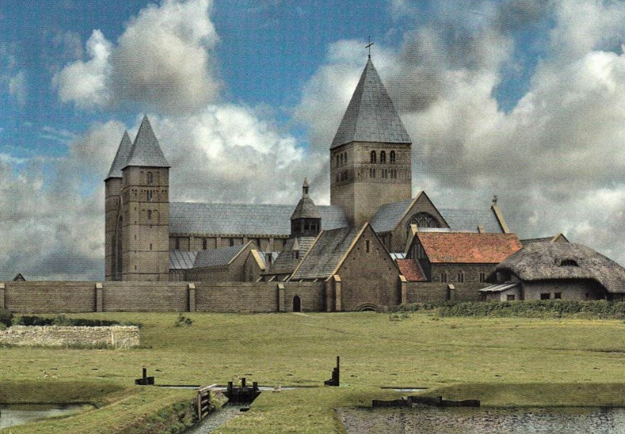
Our Parish
Eynsham village and Barnard Gate
Residents 5,000
Dwellings 2,200
Settlement since 6th century with fascinating history including Eynsham Abbey
Well catered for with many clubs, organisations, pubs, restaurants and local business
Numerous experts and enthusiasts especially around climate change and biodiversity
‘A Great Place to Belong’

Slide 5
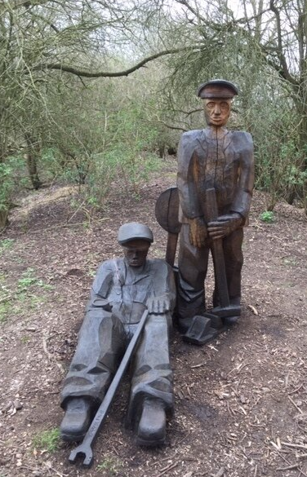
Our Situation
Garden Village
West Eynsham Strategic Development Area
Potential for an additional 3,200 dwellings
Park and Ride scheme with bus lane to Oxford
Botley West Solar Farm

Slide 6
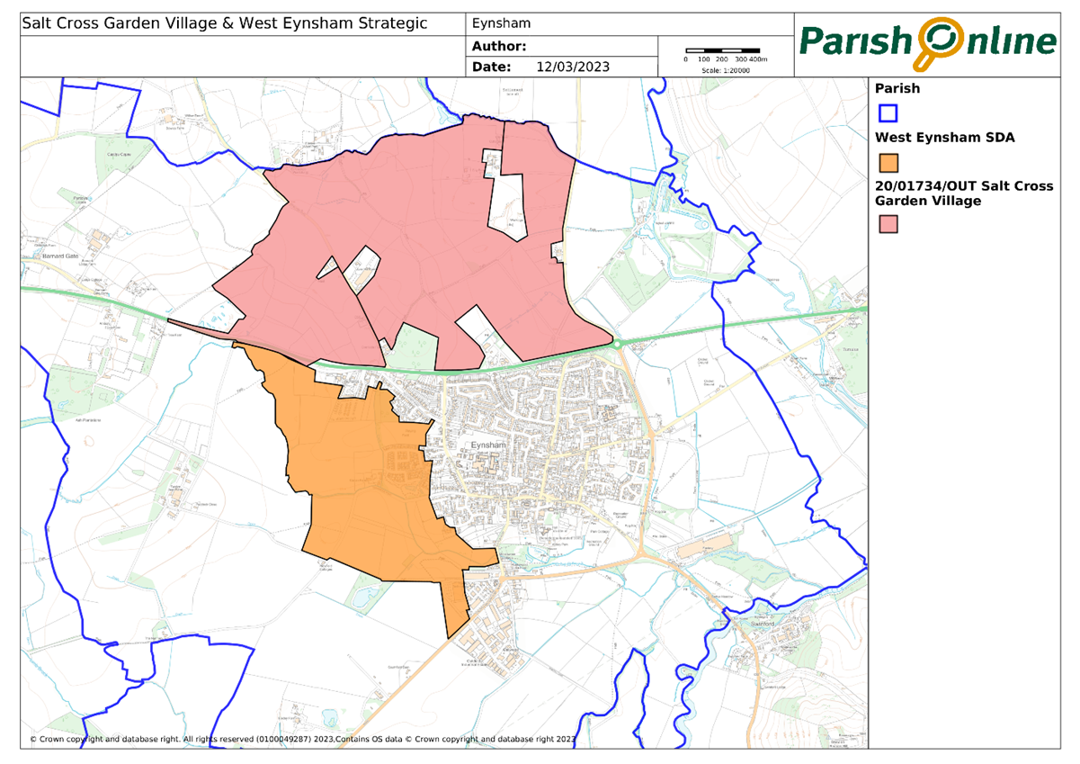

Slide 7
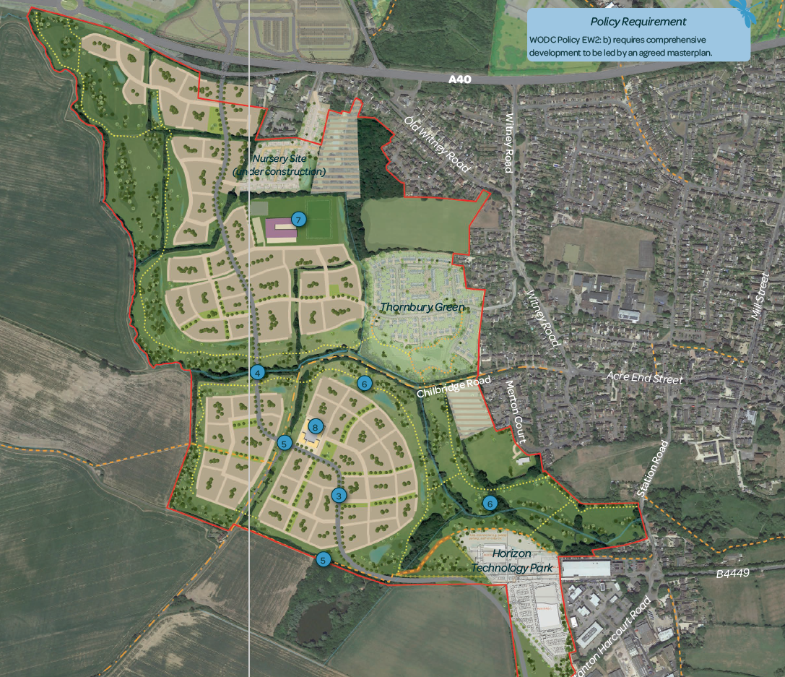

Slide 8
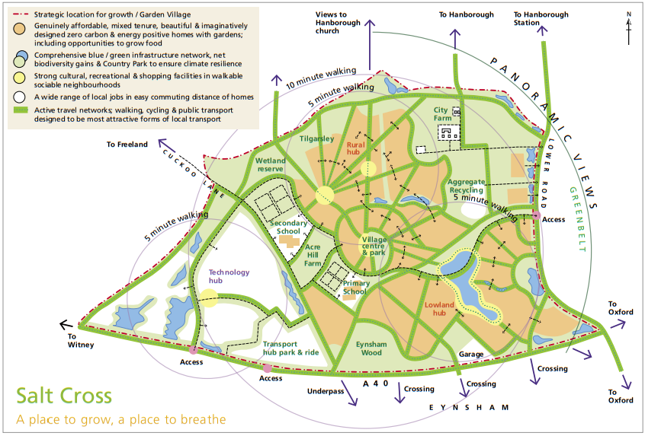

Slide 9
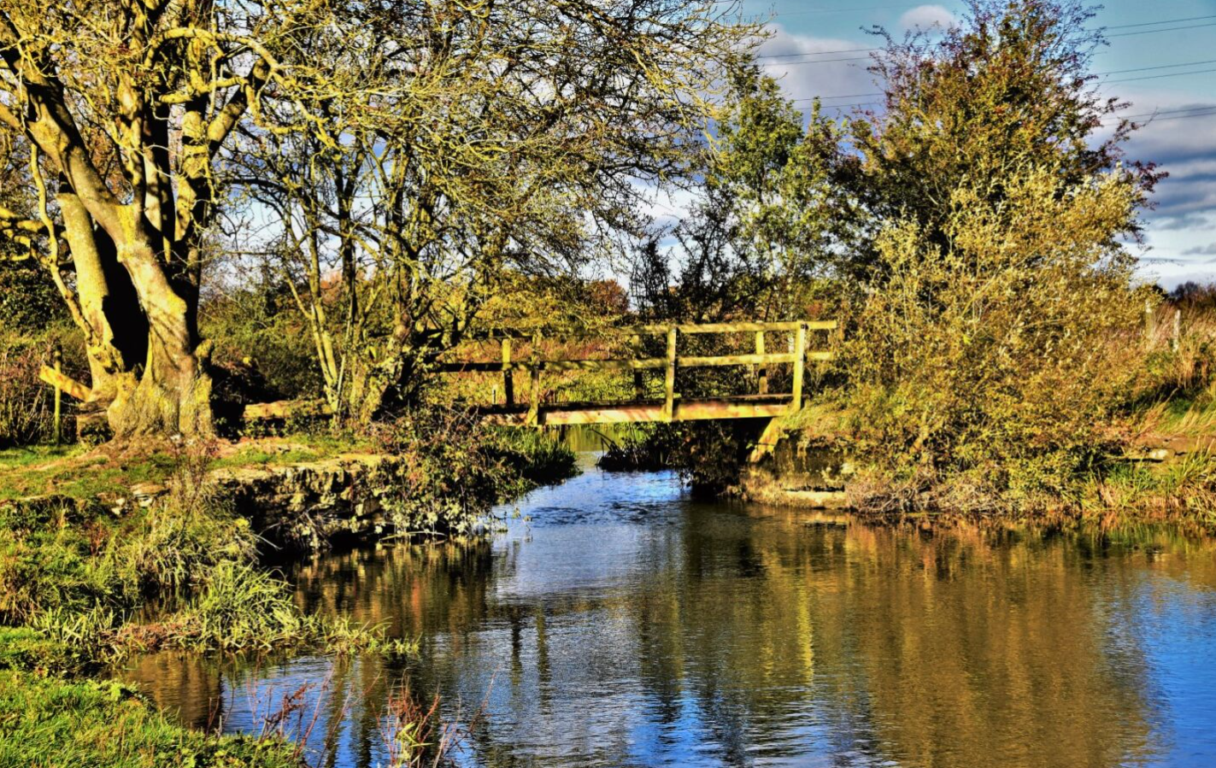
Our Priorities
Preserve the character of the village
Ensure that the developments are created to the best standard
Increase/enhance facilities for our residents

Slide 10
Our Priorities
Preserve the character of the village
Ensure that the developments are done to the best standard
Increase/enhance facilities for our residents
For me, stewardship is the difference between a housing development and a sustainable, participative and inclusive community. It neatly ties in with placemaking and creating a ‘love of place,’ Katherine Doughty, 2023.

Slide 11
Our Plan
Update the Neighbourhood plan
  Strengthen the language – could to should, may to will
  Add Design Code
  Numerous other enhancements and additions
Establish a Stewardship arrangement for the Parish
Nature Recovery Network
  Climate Emergency
  Extremely important to our residents
  EPC plays its part

Slide 12
Stewardship Proposal
Establish a stewardship arrangement for common space
Either independent trust or Parish Council
Start early prior to development commencing
Garden Village and West Eynsham and potential to retrofit prior developments
Alternative of property management receives poor feedback
  High costs
  Poor quality
  Unresponsive

Slide 13
Benefits
Community involvement
Community control
Whole place approach
Funding in perpetuity
Biodiversity balanced with amenity
Leverage our local expertise

Slide 14
Challenges
Complex to set up
Ensuring long-term engagement
Adequate funding
Engagement with developers

Slide 15
What have we learnt?
Residents Survey
2800 surveys delivered, 47 responses (Paper/Survey Monkey)
Key Findings
Nearly 100% support for Stewardship
Even split between Parish Council and Community Land Trust
Some variation depending on asset type
  buildings vs outdoor space
50% of respondents would get involved
Complex topic for residents to understand

Slide 16
What have we learnt?
Focus Group
Residents from Thornbury Green and Hazeldene Close
Key Findings
Lack of transparency
Not value for money
Lack of engagement
Lack of accountability
Poor quality work
Strong interest in alternative arrangements

Slide 17
Next Steps
Broad agreement from developers, district council and parish council
Continued support from CFO
Visit examples of successful developments with stewardship
Enshrine in S106 agreements
Revision of our Neighbourhood Plan
Consultation with parish residents and other stakeholders
Develop structure and terms of reference
  Financial modelling
Establish organisation at early stage
  Meaningful involvement during design, planning and construction
  Ready to receive assets and start managing common spaces

